Slide 1
Technology of the west!!

Slide 2
Barb wire
Prairie condition: Great plains was a prairie, and has almost no trees.
Farming problem: There was no timber for making fences, so cattle and buffalo would trample or eat your corps.

Slide 3
Barb wire
Greatly altered life in the west!
Without fencing, cattle were able to graze freely, and they had to compete for food/water.
Without fencing, farming and ranching opportunities would be very limited.

Slide 4
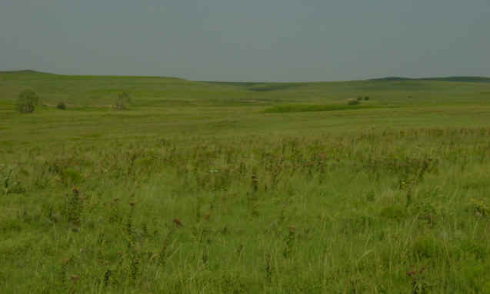
Barbed Wire

Slide 5
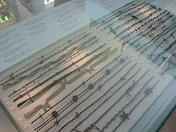
Barbed Wire

Slide 6
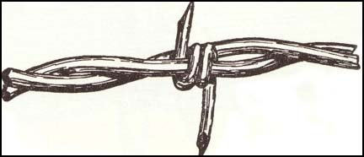
Barbed Wire

Slide 7
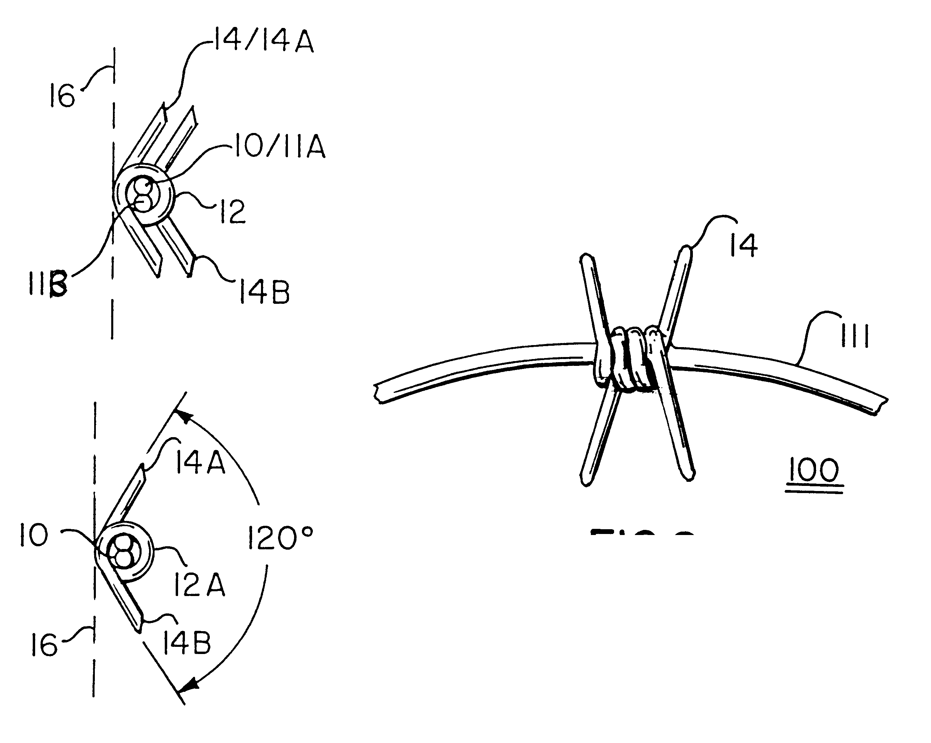
Barbed wire

Slide 8
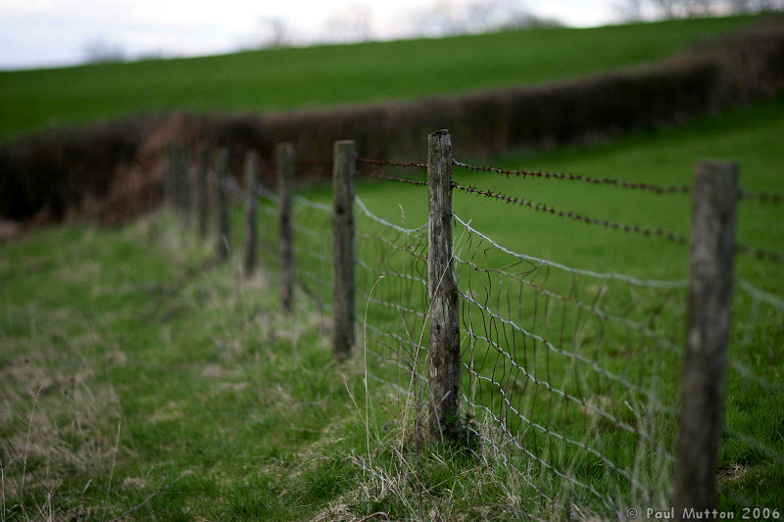
Barb wire

Slide 9
Steel plow
Prairie condition: The soil of the great Plains is hard and full of roots and rocks.
Farming problem it took a lot of time and effort to plant your crops.
Also referred to as Grasshopper plows

Slide 10

Steel plow

Slide 11
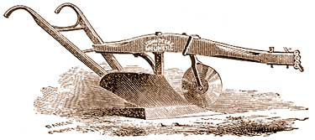
Steel plow

Slide 12
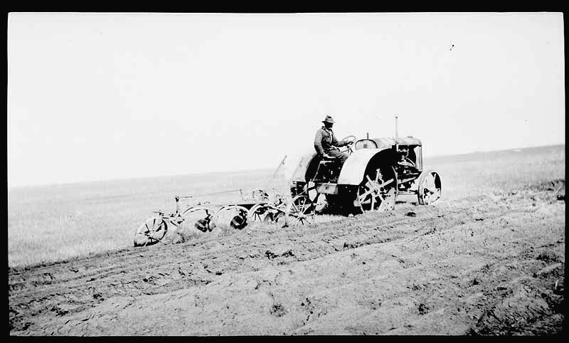
Steel plow

Slide 13
Reaper
Prairie condition: Hailstorms and freezing weather
Farming problem: Your crops would be damaged and killed by the harsh weather before you could harvest.

Slide 14
Reaper
Cut grain and swept it onto a platform, from which it could be raked off to the ground and then bundled.

Slide 15
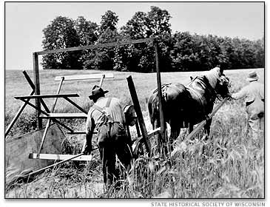
reaper

Slide 16
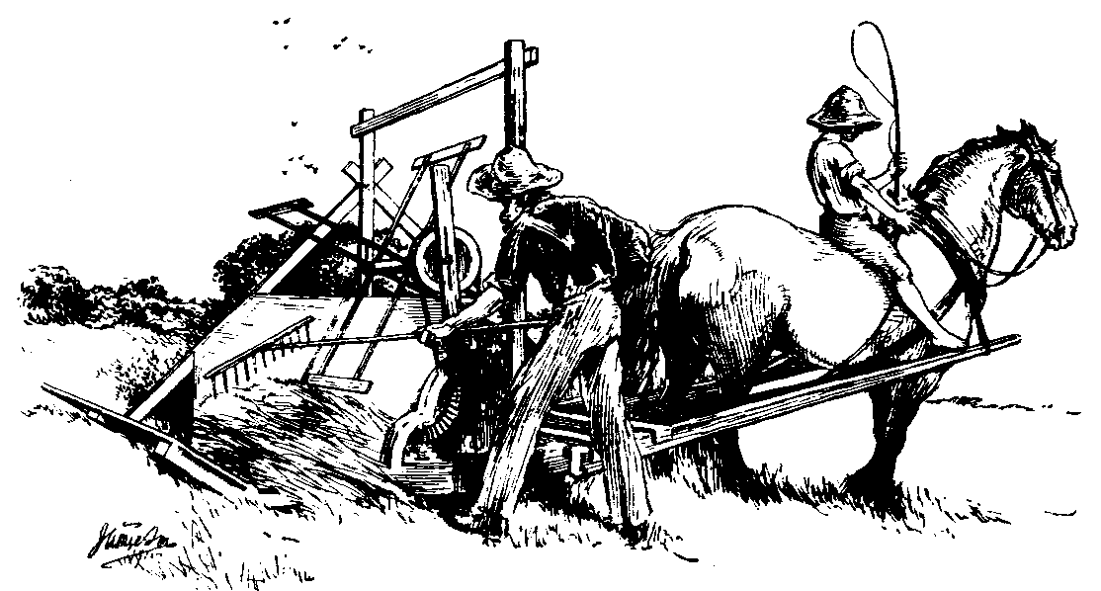
Reaper

Slide 17
Steel windmill
Prairie condition: Dry land, unpredictable rainfall.
Farming problem: It was difficult to water or irrigate crops.

Slide 18
Steel Windmill
Catch wind to pump water from underground

Slide 19
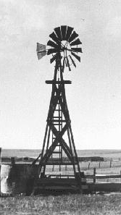
Steel Windmill

Slide 20
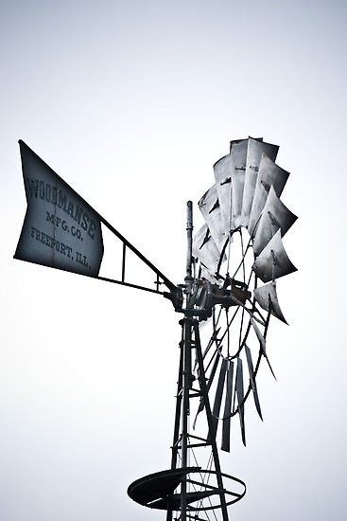
Steel Windmill

Slide 21
1830 - About 250-300 labor-hours required to produce 100 bushels (5 acres) of wheat with walking plow, brush harrow, hand broadcast of seed, sickle, and flail
1890 - 40-50 labor-hours required to produce 100 bushels (5 acres) of wheat with gang plow, seeder, harrow, binder, thresher, wagons, and horses

Slide 22
Telegraph
Prairie condition: Far from cities of the East and Mississippi River Valley
Farming Problem: You were isolated from friends, family and information

Slide 23
Telegraph
Transmitted electric signals over wires from location to location that translated into a message
Morse Code

Slide 24

Telegraph

Slide 25
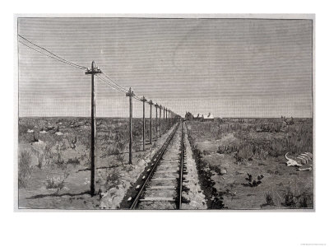
Telegraph

Slide 26
railroad
Prairie condition: Far from cities of the East and Mississippi River Valley
Farming Problem: It was hard to get out West by covered wagon, and hard to get products out there
Cut time, and cost to ship items down dramatically

Slide 27
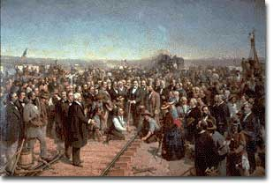
Railroad

Slide 28
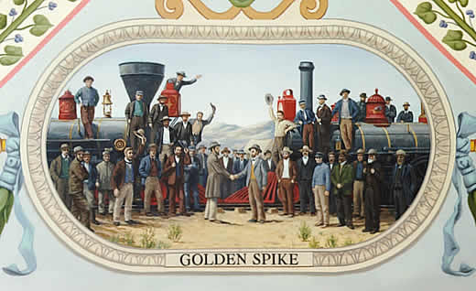
Railroad

